Slide 1
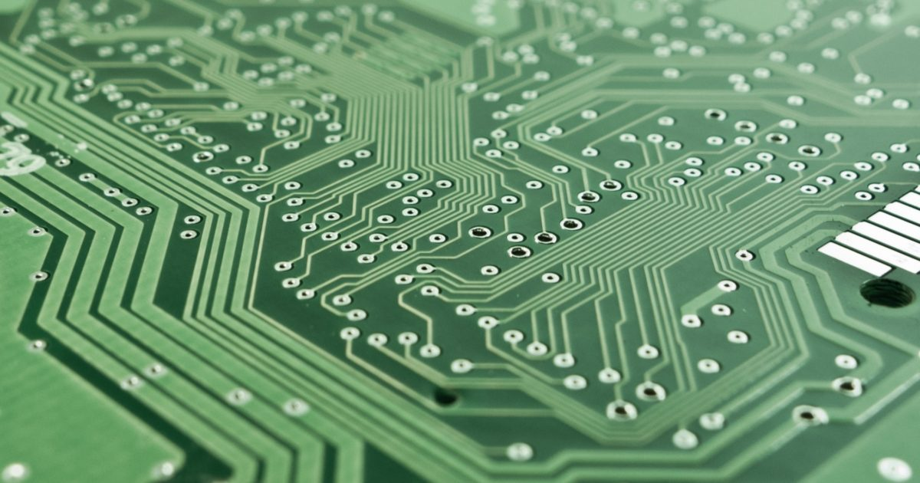

Assignment 10 - IoT Master Writer/Slave Receiver
Student Name:
Santiago Cruz
Student ID:
200540981
04/02/2024
This Photo by Unknown author is licensed under CC BY.

Slide 2
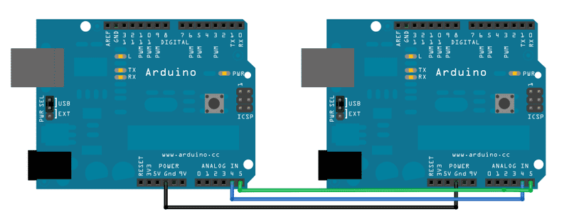
Master Writer/Slave Receiver
Master Receiver:
Initiates communication
Controls data flow
May send commands or data
Slave Receiver:
Receives signals from the master
Responds to commands
May send data back to the master

Slide 3


Two use cases of IoT using Master Writer/Slave Receiver on Arduino
Smart Homes:
Thermostats that adjust the temperature automatically
Lights that turn on/off based on occupancy or time
Industrial Automation:
Machines that monitor and optimize production processes
Sensors that detect equipment failures and trigger maintenance alerts

Slide 4
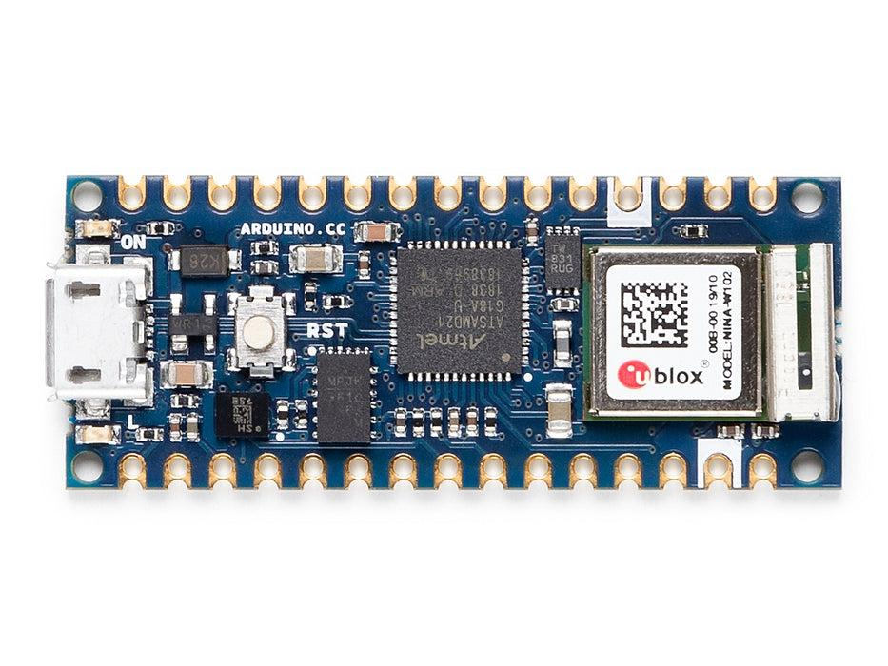
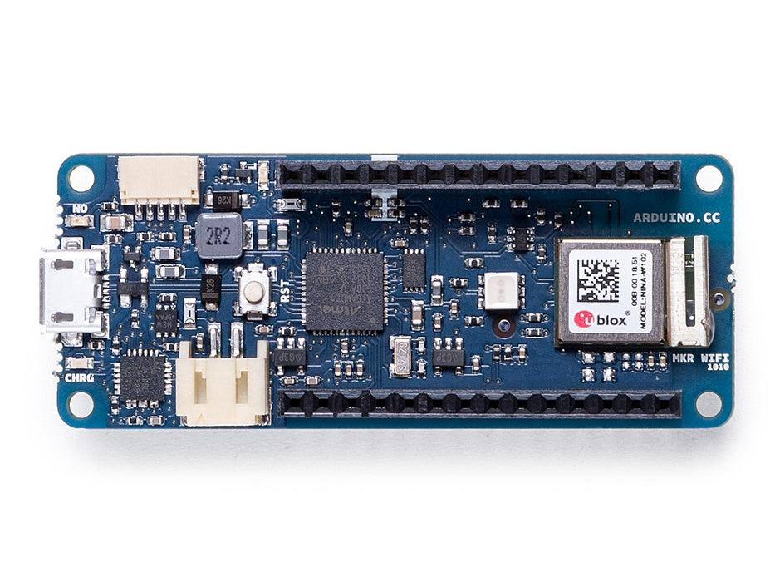
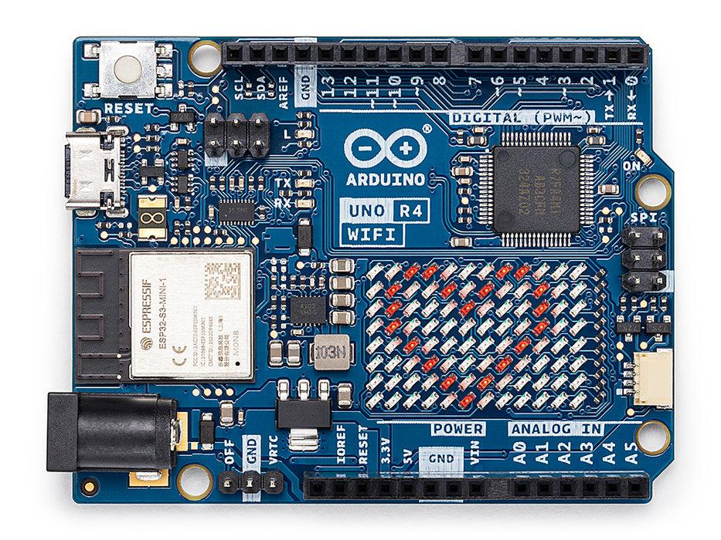
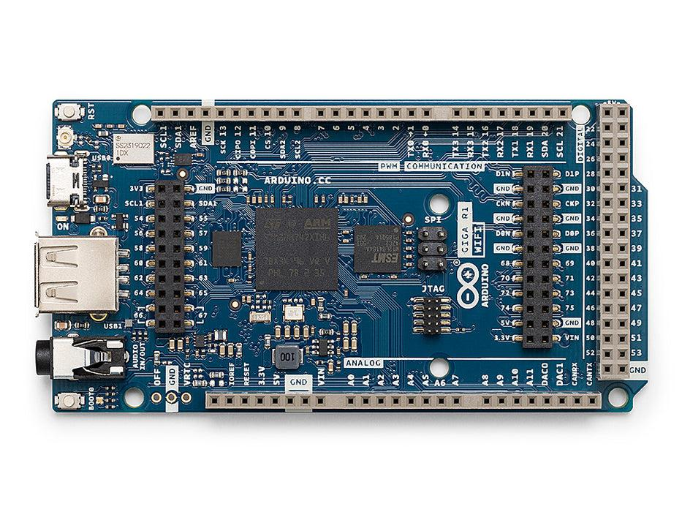
Arduino Family
Nano Family:
Arduino Nano 33 IoT, Arduino Nano RP2040 Connect, Arduino Nano ESP32, etc.
MKR Family:
Arduino MKR 1000 WiFi, Arduino MKR WiFi 1010, Arduino MKR WAN 1300, etc.
Classic Family:
Arduino UNO R4 Minima, Arduino UNO R4 WiFi, Arduino UNO R3, etc.
Mega Family:
Arduino Mega 2560 Rev3, Arduino Due, and Arduino GIGA R1 WiFi

Slide 5
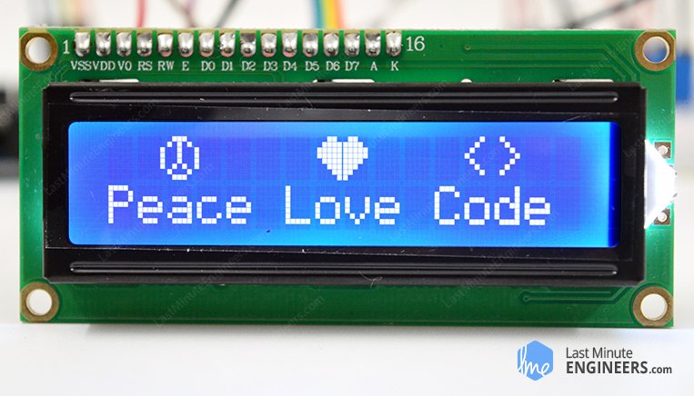
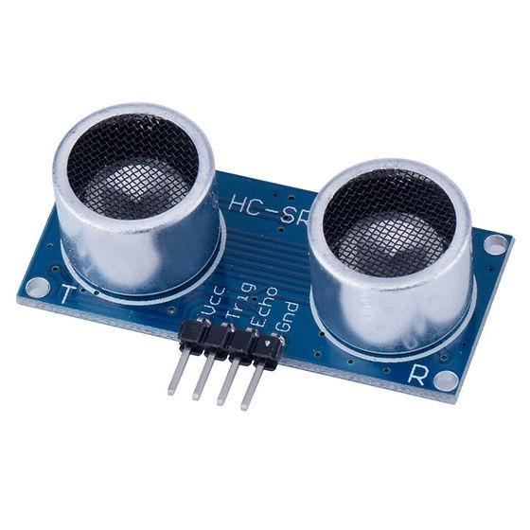
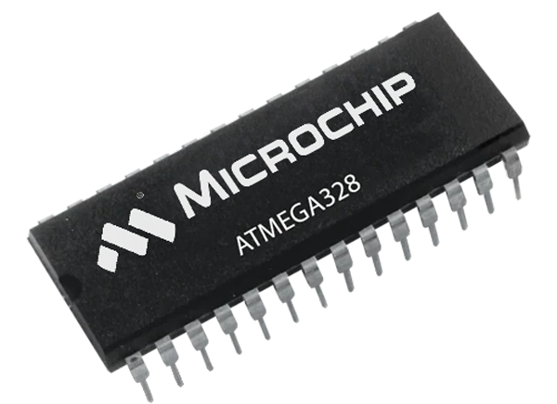

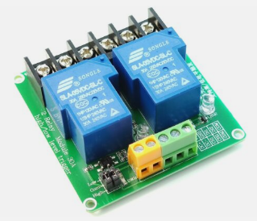
10 Electronic Components and their Functionalities
Microcontroller: Acts as the brain of the system, controlling all the components and processes.
Sensors: Detect physical parameters such as temperature, humidity, light, motion, etc.
Actuators: Convert electrical signals into physical actions, such as motors, solenoids, or relays.
Relays: Used to switch high voltage or high current devices on and off.
LCD Display: Provides visual feedback on the system's status and data.

Slide 6
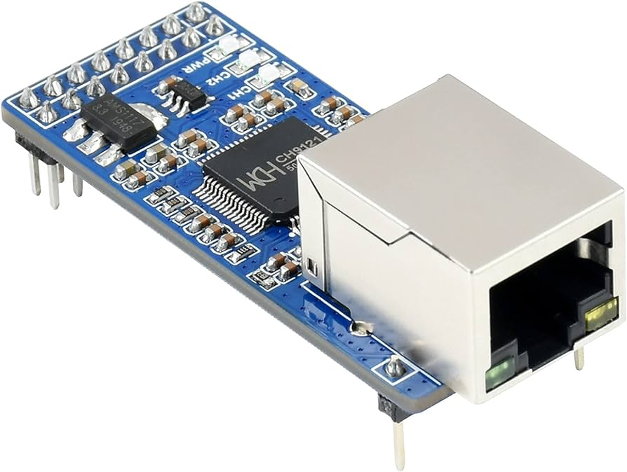
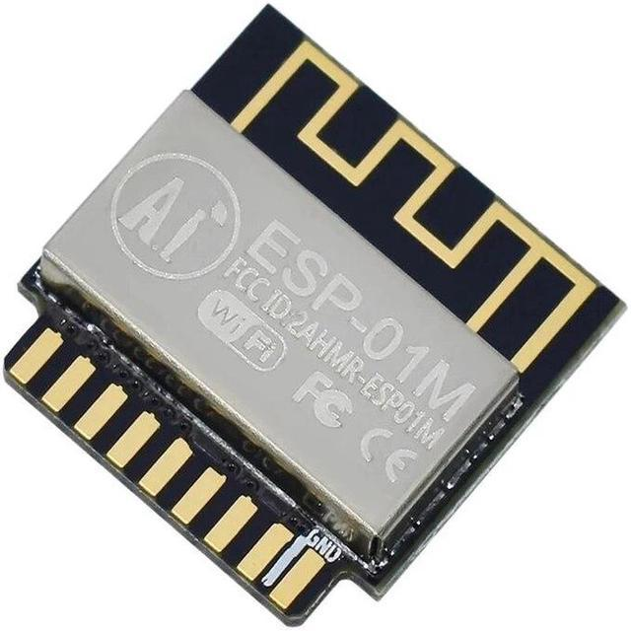
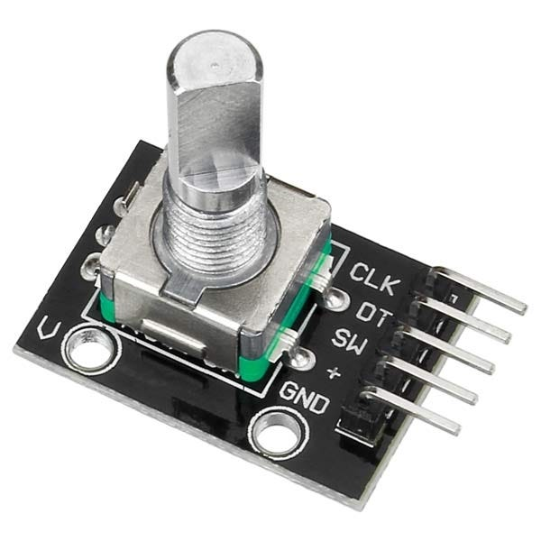
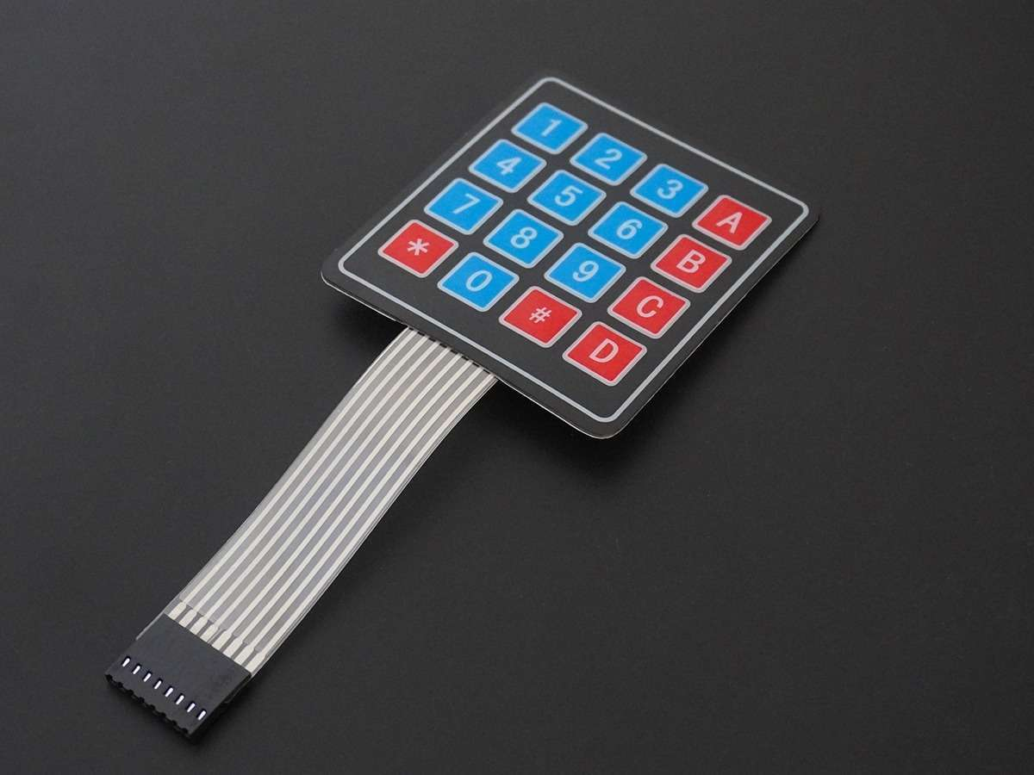
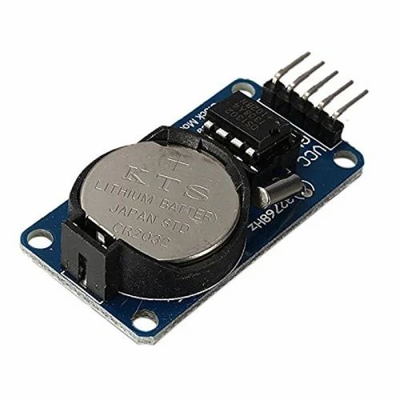
6) Keypad: Allows users to input data or commands into the system.
7) Encoder: Measures the position or rotation of a mechanical component.
8) RTC(Real−TimeClock): Keeps track of time for scheduling tasks or events.
9) EthernetModule: Enables communication with other devices or networks.
10) WirelessModule: Allows for wireless communication with other devices or systems.

Slide 7
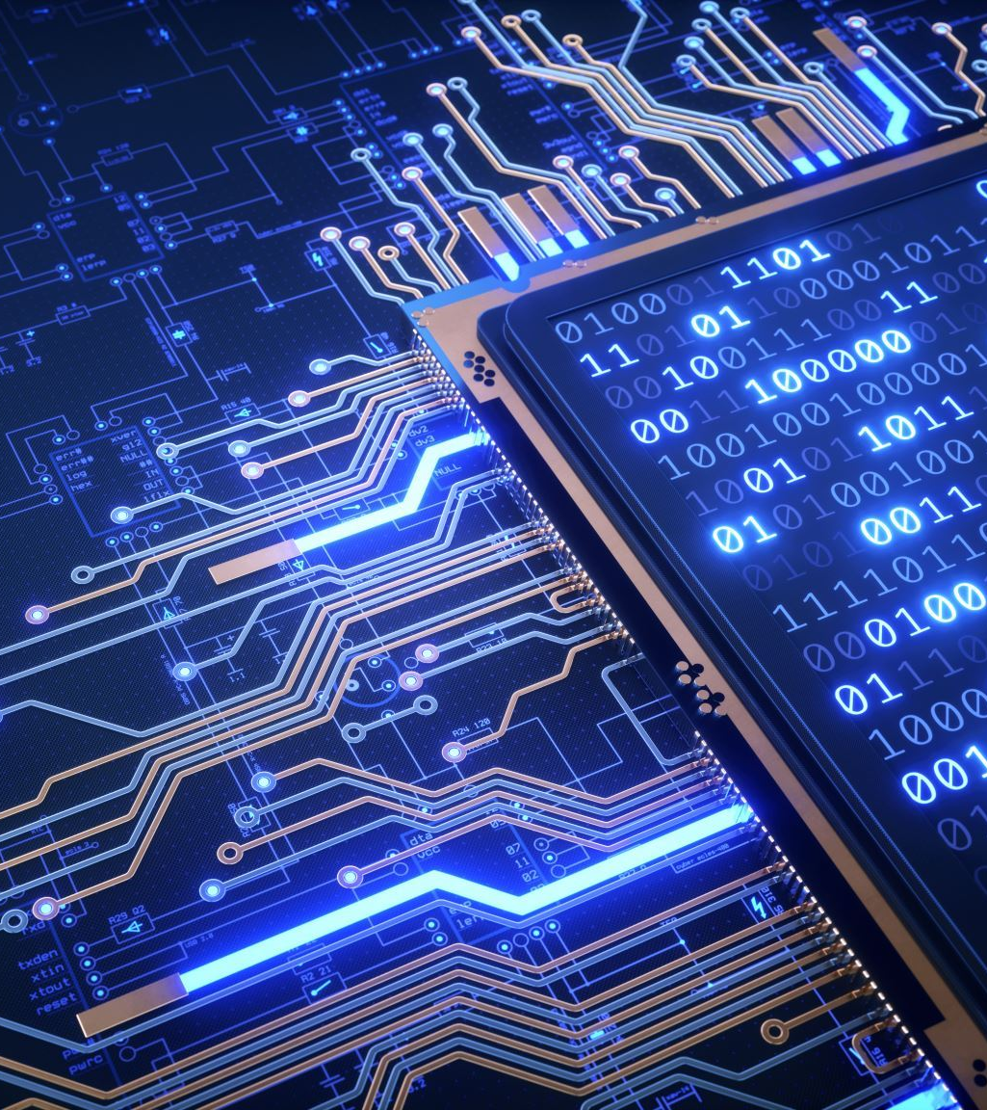
References
Master Writer/Slave Receiver | Arduino
Arduino Hardware | Arduino

